Slide 1
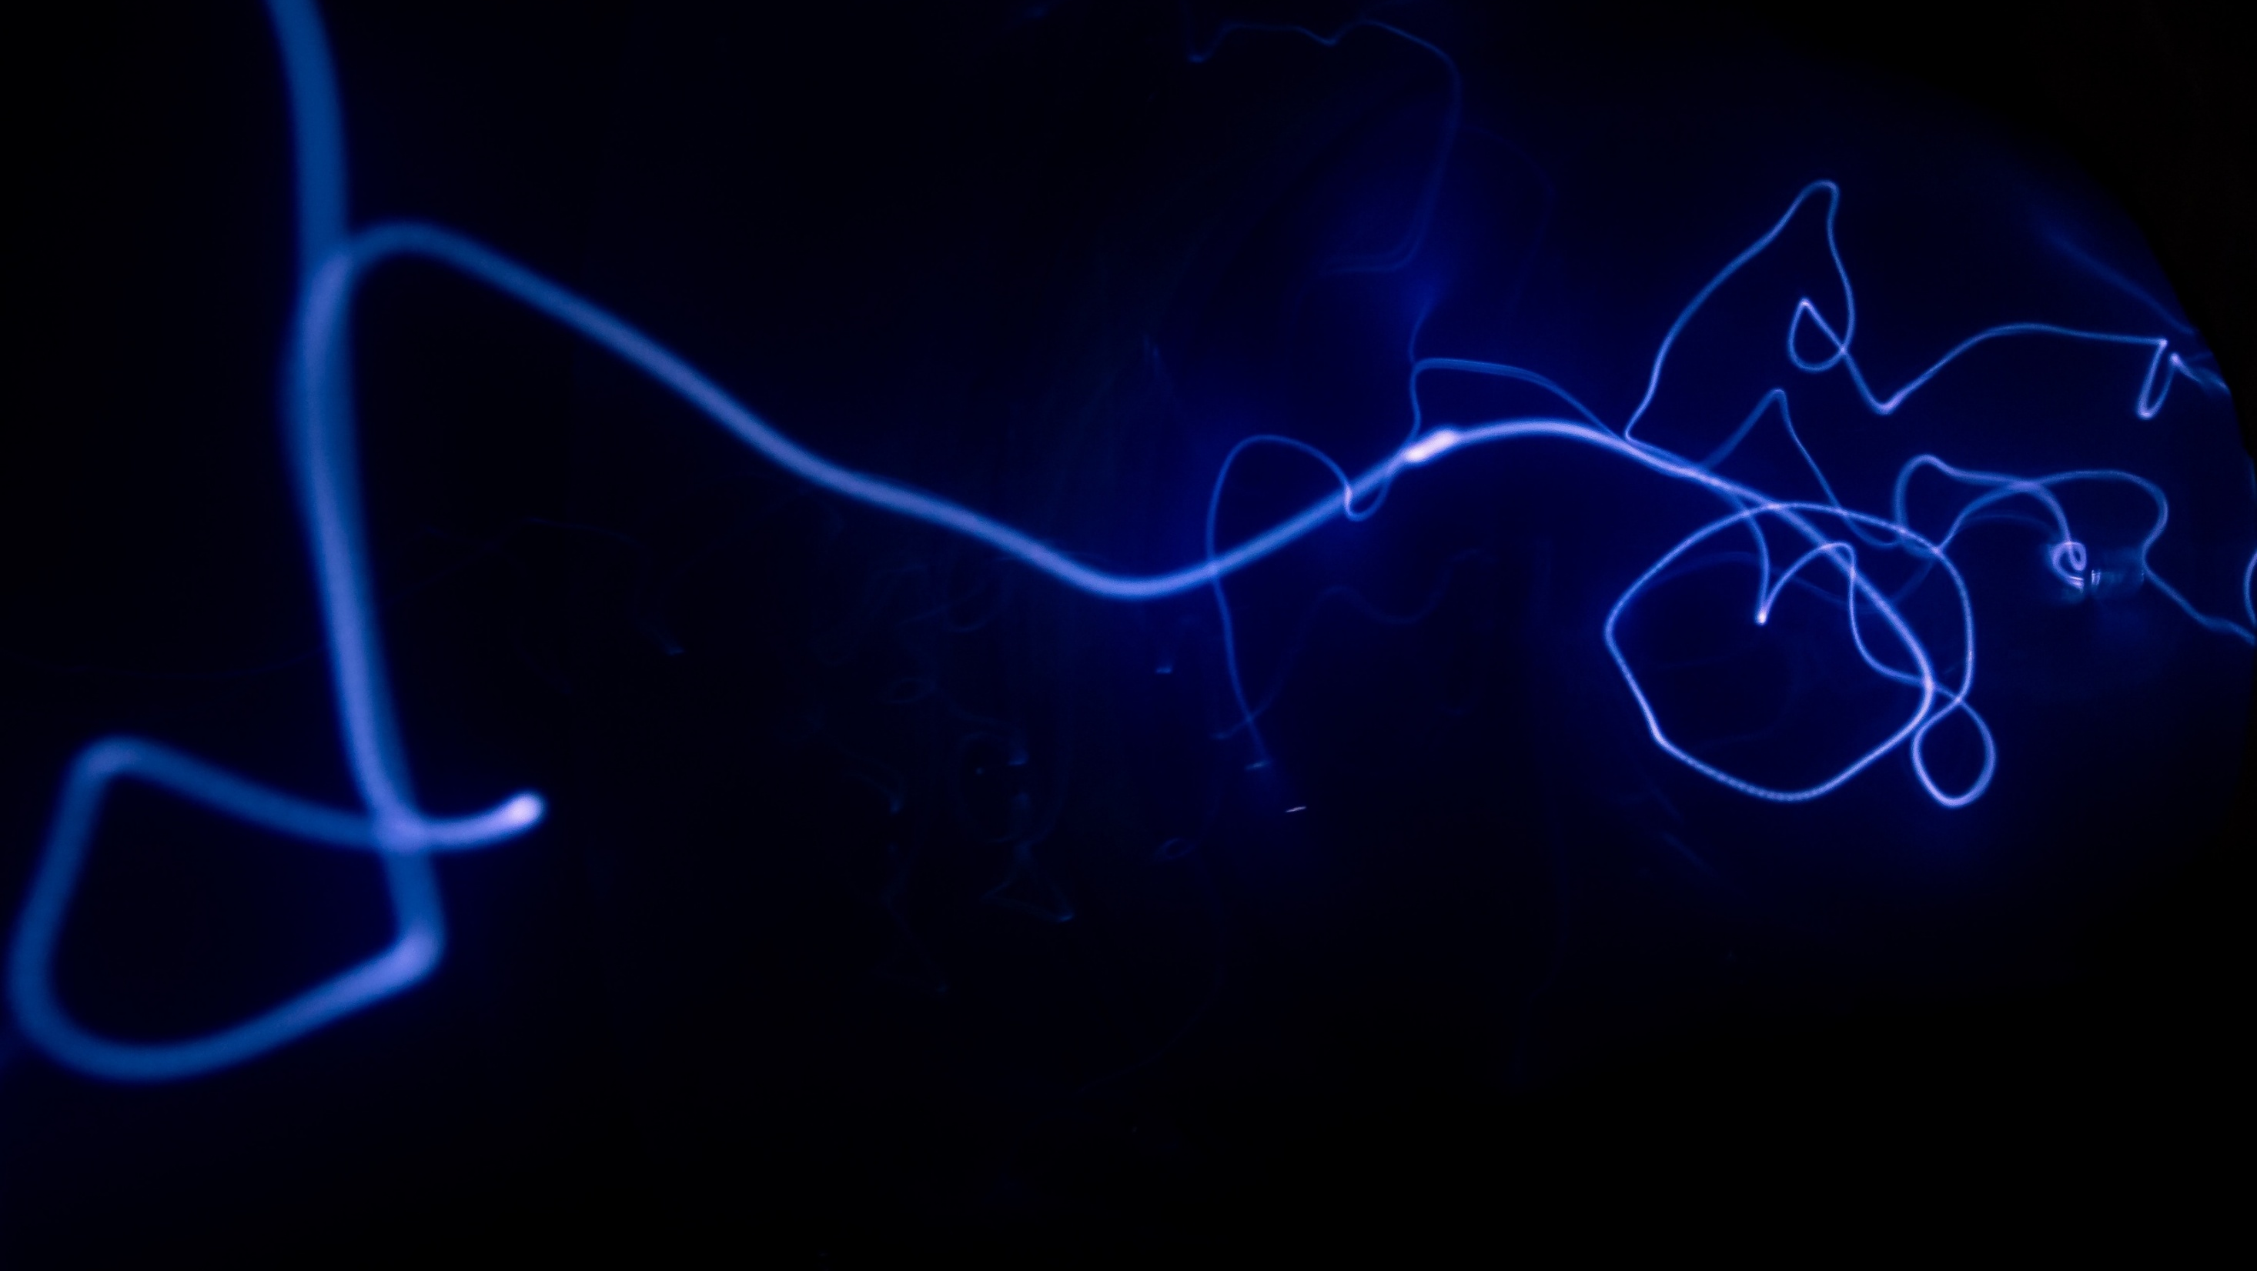
Face Recognition and Emotion Detection using Deep Learning
Samapti Dikshit
Apr, 2025
AI/ML for Industry
Continuing Education Programme
Indian Institute of Technology Delhi

Slide 2
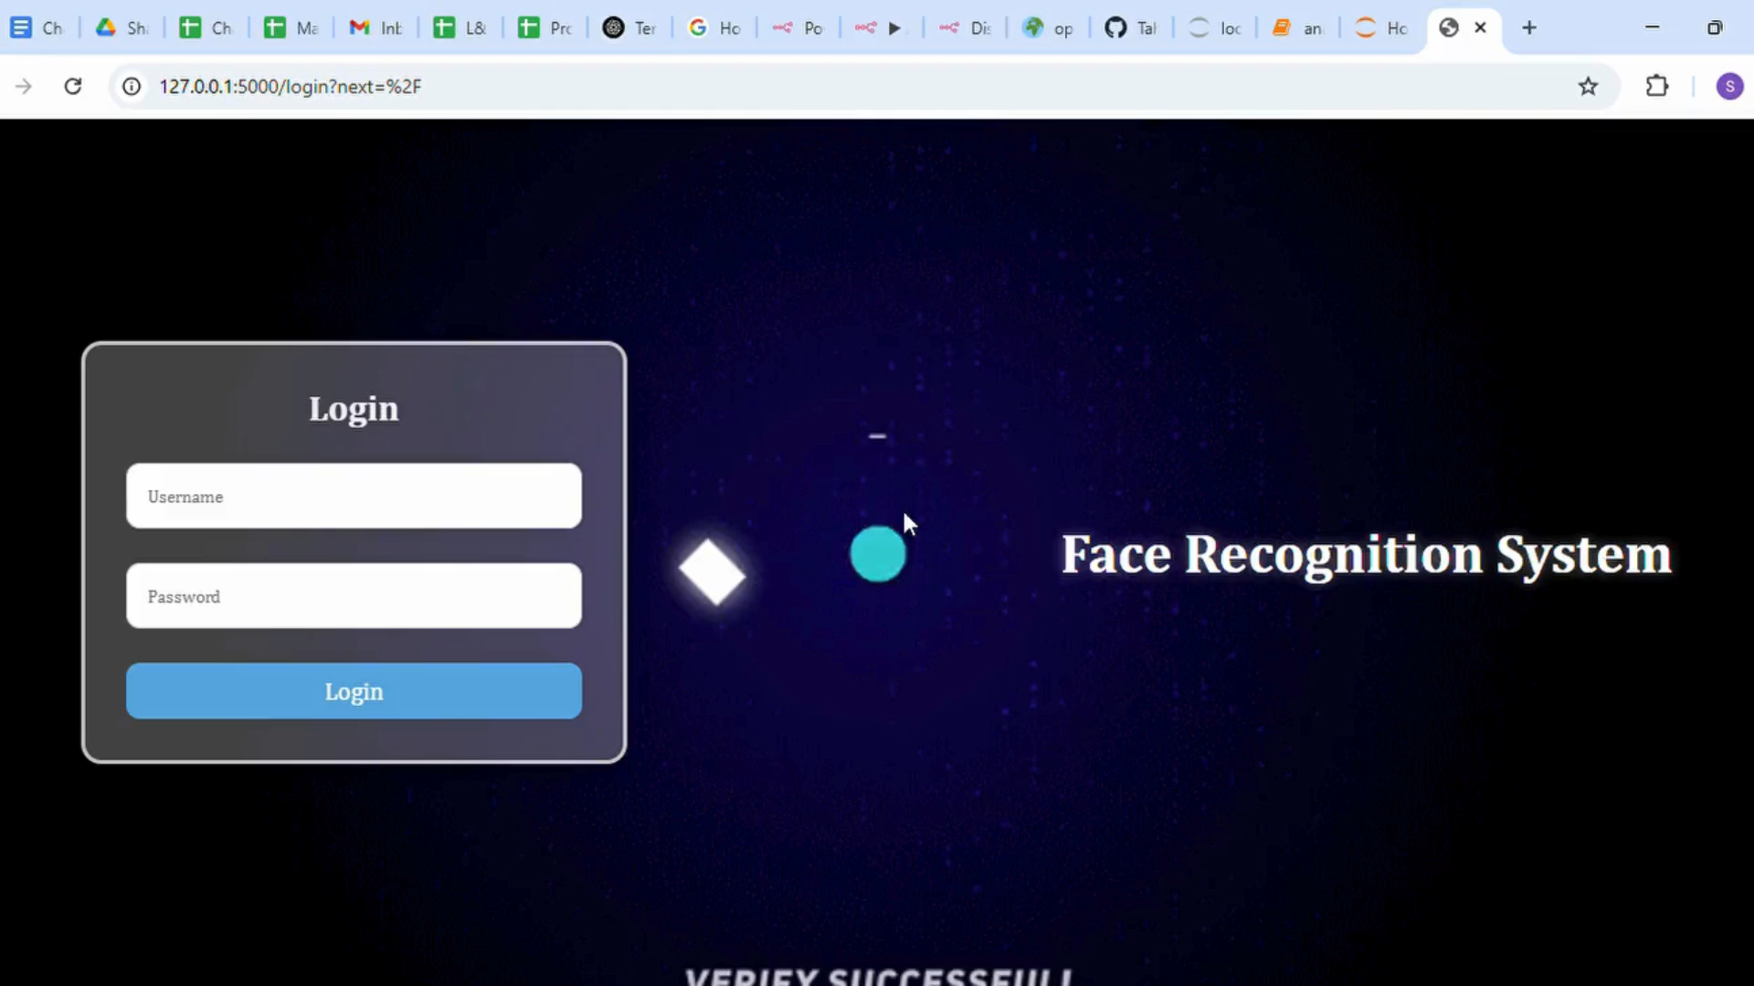
Project Demonstration

Slide 3
Background
With the rise of intelligent systems, there’s a growing need for machines that can both recognize identities and understand human emotions in real-time. Most current solutions focus on one or the other.
This project bridges that gap by combining:
Face recognition using a VGG16-based model (RGB)
Emotion detection using a custom CNN (Grayscale)
Integrated via a Flask web app with MongoDB, the system delivers real-time, dual-function recognition—enabling smarter, emotionally aware human-computer interactions.

Slide 4
Problem Statement
Most existing systems handle either face recognition or emotion detection—but not both simultaneously, and rarely in real-time. This project addresses the challenge of building an integrated system that:
Recognizes faces using a VGG16-based model (RGB).
Detects emotions using a custom CNN (grayscale).
Operates in real-time via a Flask web interface.
Logs recognition events using MongoDB.
The goal is to create a responsive, scalable, and emotion-aware system suitable for real-world applications.

Slide 5
Methodology, Datasets, and Tools used
Methodology
Face Recognition: Trained a VGG16-based model on RGB facial images for identity classification.
Emotion Detection: Developed a custom CNN to classify grayscale facial expressions into 7 emotion categories.
Integration: Combined both models into a Flask web app for real-time inference, with MongoDB for backend logging.
Datasets
Face Dataset:
Collected manually via webcam under varied lighting and orientations; labeled using LabelMe.
Emotion Dataset:
Grayscale images resized to 48×48, categorized into classes like Happy, Sad, Angry, Surprise, etc.

Slide 6
Methodology, Datasets, and Tools used
Tools:
Tool / Library | Purpose
OpenCV | Image capture from webcam, real-time frame processing
face_recognition | Face detection and encoding from image frames
TensorFlow / Keras | Model design, training, evaluation, and inference
Albumentations | Data augmentation (flip, brightness, blur, noise, rotation)
Flask | Backend web server and user interface integration
MongoDB | Storage of recognition logs and user data
LabelMe | Manual annotation of facial bounding boxes in the dataset
Matplotlib | Data visualization (accuracy/loss plots, sample previews)
TQDM | Progress bars for tracking image processing loops
NumPy / Pandas | Array manipulation, dataset loading, and preprocessing
sklearn (LabelEncoder) | Label encoding and transformation for emotion classification

Slide 7
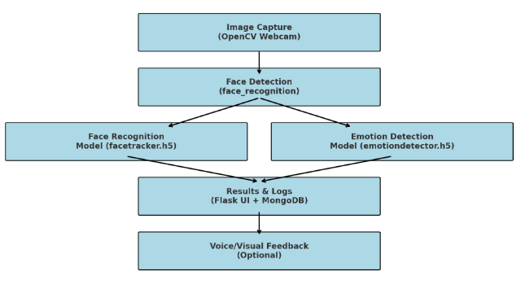
Methodology, Datasets, and Tools used

Slide 8
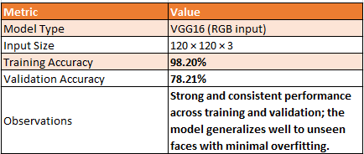
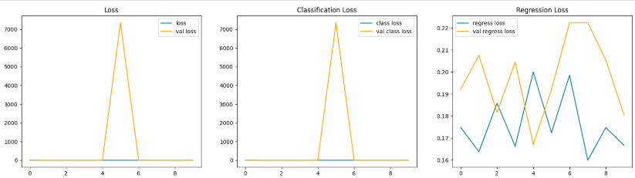
Results 1: Model Performance
The system comprises two deep learning models: one for face recognition and the other for emotion detection. Both models were evaluated based on training accuracy, validation/test performance, and practical behavior in real-time deployment.
Face Recognition Model – facetracker.h5

Slide 9
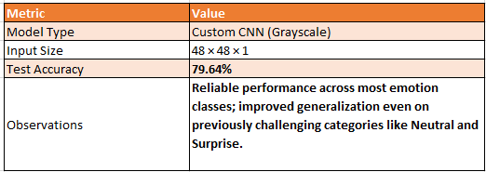
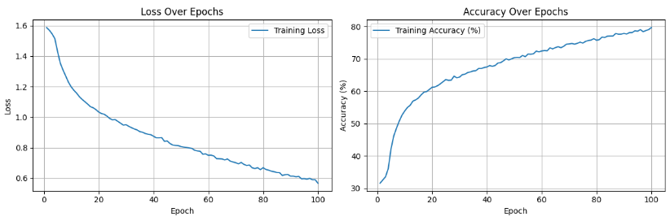
Results 1: Model Performance
The system comprises two deep learning models: one for face recognition and the other for emotion detection. Both models were evaluated based on training accuracy, validation/test performance, and practical behavior in real-time deployment.
Emotion Detection Model – emotiondetector.h5

Slide 10
Flask-Based GUI System
Developed using Flask for seamless integration of both models.
User Login & Session Management secured via Flask-Login.
Live webcam feed enables real-time face capture.
Detected face is processed by:
facetracker.h5 for identity recognition (RGB)
emotiondetector.h5 for emotion classification (grayscale)
Results Displayed Instantly in the UI: user name + emotion.
Logs are stored in MongoDB with timestamps.
Optional: Voice feedback confirms recognition as announce.

Slide 11
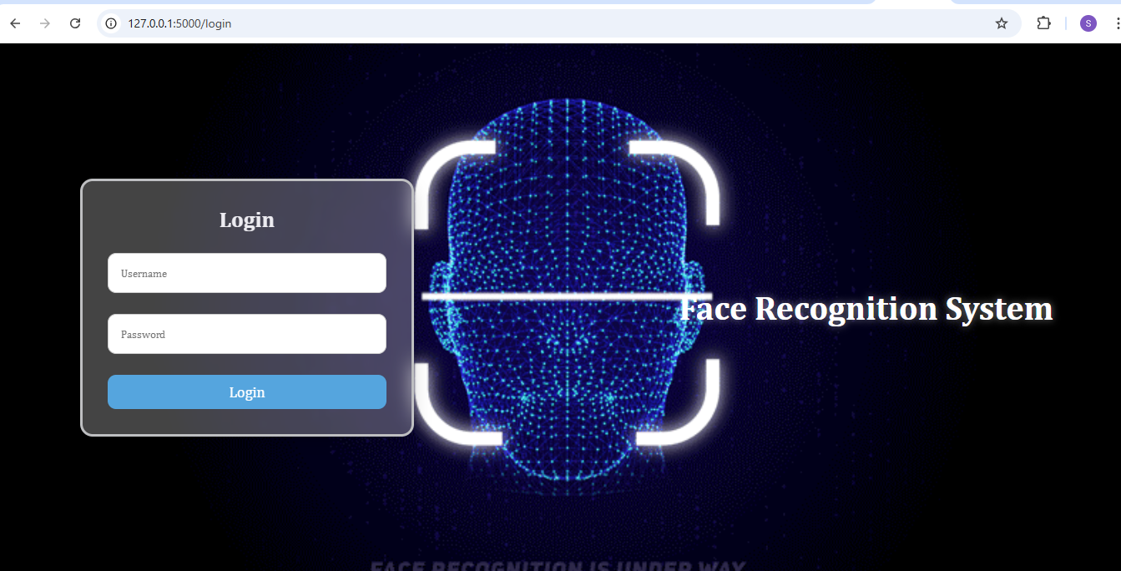
Flask-Based GUI System
Login System:

Slide 12
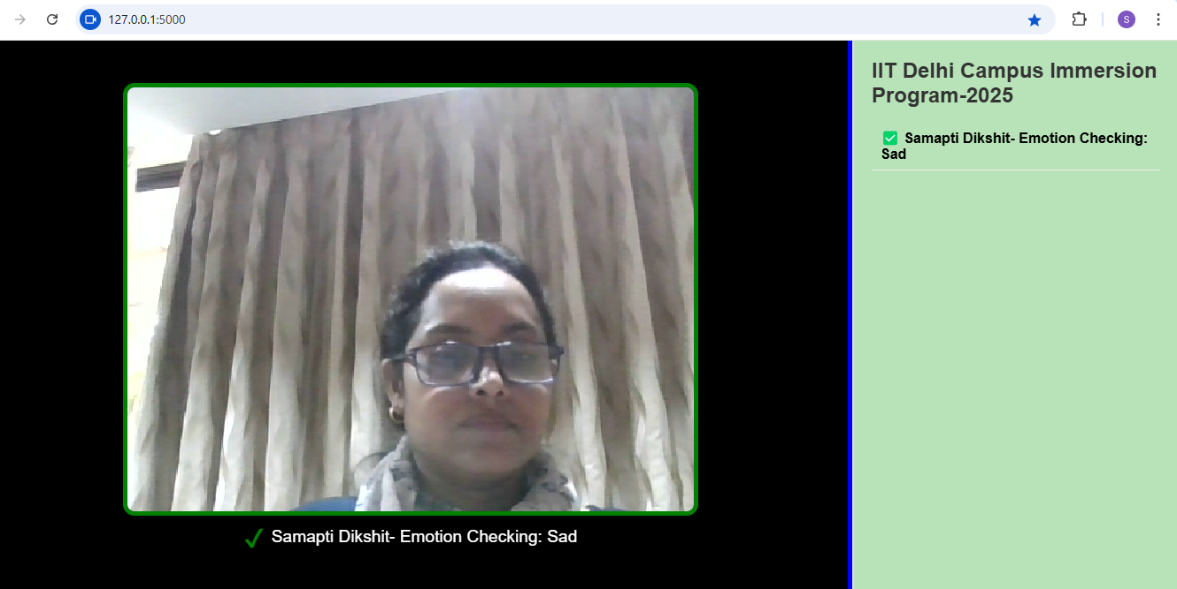
Flask-Based GUI System
Recognition System:

Slide 13
Results 2: Security Analysis
Secure Login: Flask-Login ensures authenticated access and session control.
Input Validation: All webcam data are sanitized before processing.
Model Safety: Models run server-side and are not exposed to users.
Secure Logging: MongoDB logs only non-sensitive data (name, timestamp, emotion).
Voice Privacy: Voice feedback is local; no audio is stored or transmitted.
System is secure for academic/demo use. Future deployment can add HTTPS, JWT, and cloud-level encryption.

Slide 14
Conclusions
Successfully built a real-time system that performs both face recognition and emotion detection.
Integrated two models:
VGG16-based model for face identification (RGB)
Custom CNN for emotion classification (Grayscale)
Developed a user-friendly Flask web interface with:
Live webcam input
Visual + optional voice feedback
MongoDB for secure recognition logging
Achieved high accuracy with fast inference and smooth UI performance.
System demonstrates strong potential for smart automation, user-aware interfaces, and AI-powered human-computer interaction.

Slide 15


